Slide 1
JAVA
ARRAYS

Slide 2
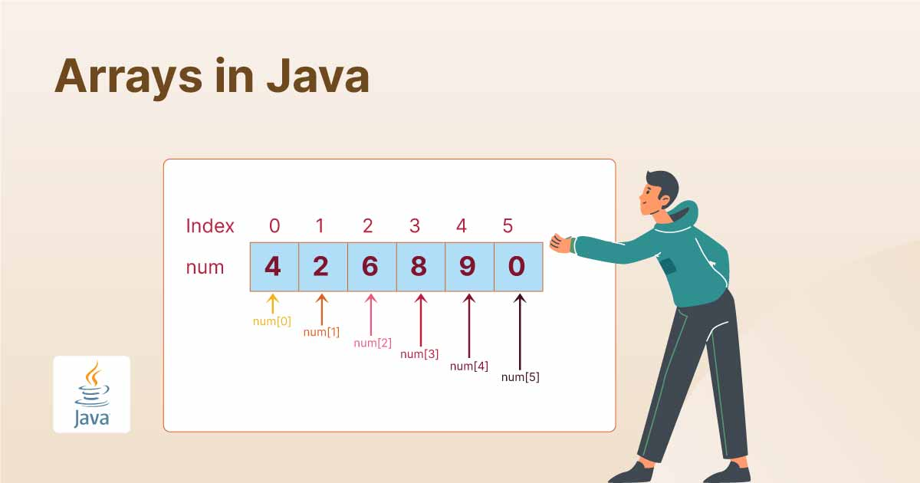
ARRAYS
An array is a data structure that allows you to store multiple elements of the same type in a contiguous block of memory.
Arrays provide a way to organize data so that a related set of values can be easily accessed and manipulated.
Each element in an array can be accessed using an index, with the first element having an index of 0.

Slide 3
Key Characteristics of Arrays
Fixed Size: The size of an array is defined when it is created and cannot be changed.
Homogeneous Elements: All elements in an array are of the same data type.
Contiguous Memory Locations: Elements are stored in contiguous memory locations, making access fast and efficient.
Indexed Access: Elements can be accessed directly using their index.

Slide 4
Types of Arrays in Java
One-Dimensional Arrays: A single row or a list of elements.
Multi-Dimensional Arrays: Arrays of arrays, such as a matrix (2D array) or higher-dimensional structures.

Slide 5
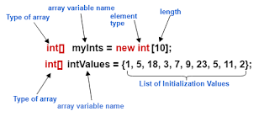
One-Dimensional Array in Java
A one-dimensional array is a collection of elements of the same type, stored in a contiguous memory location. The elements can be accessed using an index.

Slide 6
Array Basic Operations
Array Declaration Example:
int[] numbers;
Create an Array
numbers = new int[5];
Access an Element of an Array
numbers[0] = 10;
int firstElement = numbers[0];
Array Length
int length = numbers.length;

Slide 7
Example :
class Main {
public static void main(String[] args)
{
int[] arr;
arr = new int[5];
arr[0] = 10;
arr[1] = 20;
arr[2] = 30;
arr[3] = 40;
arr[4] = 50;
for (int i = 0; i < arr.length; i++)
System.out.println("Element at index " + i
+ " : " + arr[i]);
}
}

Slide 8
Example :
public class Sample1 {
public static void main(String[] args) {
// Declare and initialize an array of integers
int[] numbers = {1, 2, 3, 4, 5};
// Access and print each element using a loop
for (int i = 0; i < numbers.length; i++) {
System.out.println("Element at index " + i + ": " + numbers[i]);
} } }

Slide 9
Example of Arrays using foreach :
public class PrintArrayElements {
public static void main(String[] args) {
int[] numbers = {1, 2, 3, 4, 5};
System.out.println("Array elements:");
for (int num : numbers) {
System.out.println(num);
}
}
} /*
for (int i = 0; i < numbers.length; i++) {
int num = numbers[i];
System.out.println(num);
}
*/

Slide 10
Example to print the entire array without the any loop.
import java.util.Arrays;
public class Sample1 {
public static void main(String[] args) {
int[] numbers = {1, 2, 3, 4, 5};
System.out.println(Arrays.toString(numbers));
}
}

Slide 11
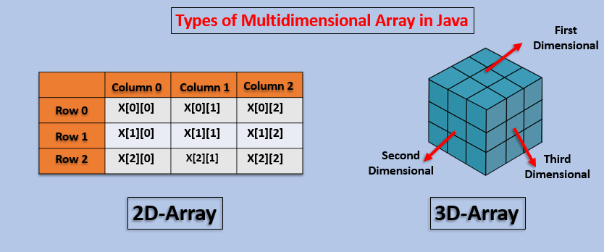
Multi-Dimensional Array in Java
A multi-dimensional array is an array of arrays. The most common type is the two-dimensional array, which can be visualized as a table with rows and columns.

Slide 12
Example :
public class Sample1 {
public static void main(String[] args) {
int[][] matrix = {
{1, 2, 3},
{4, 5, 6},
{7, 8, 9} };
for (int row = 0; row < matrix.length; row++) {
for (int col = 0; col < matrix[row].length; col++) {
System.out.print(matrix[row][col] + " "); }
System.out.println(); // Print a new line after each row
} }

Slide 13
public class Sample1 {
public static void main(String[] args) {
int[][] matrix = {
{1, 2},
{3, 4} };
System.out.println("Matrix:");
for (int[] row : matrix) {
for (int element : row) {
System.out.print(element + " ");
}
System.out.println();
} } }

Slide 14
import java.util.Scanner;
public class 2DArray {
public static void main(String[] args) {
Scanner sc = new Scanner(System.in);
System.out.print("Enter number of rows: ");
int rows = sc.nextInt();
System.out.print("Enter number of columns: ");
int cols = sc.nextInt();
int[][] arr = new int[rows][cols];
System.out.println("Enter the elements:");
for (int i = 0; i < rows; i++) {
for (int j = 0; j < cols; j++) {
arr[i][j] = sc.nextInt();
}
}
System.out.println("The 2D array is:");
for (int i = 0; i < rows; i++) {
for (int j = 0; j < cols; j++) {
System.out.print(arr[i][j] + " ");
}
System.out.println();
}
sc.close();
}
}

Slide 15
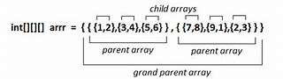
Three-Dimensional Array
A three-dimensional array is an array of arrays of arrays, adding a third layer to the structure.
Each element is accessed by specifying three indices: row, column, and depth (or height).
Syntax: int[][][] arrayName = new int[rows][columns][depth];

Slide 16
Representing sales data for different products in multiple stores across several months. Rows: Products, Columns: Stores, Depth: Months.

Slide 17
public class SalesData {
public static void main(String[] args) {
int[][][] sales = {
{ {200, 300}, {250, 400} }, // Product 1
{ {150, 280}, {180, 320} } // Product 2
};
for (int i = 0; i < sales.length; i++) {
System.out.println("Product " + (i + 1) + ":");
for (int j = 0; j < sales[i].length; j++) {
for (int k = 0; k < sales[i][j].length; k++) {
System.out.print(sales[i][j][k] + " ");
}
System.out.println();
}
System.out.println();
}
}
}

Slide 18
TASKS
Scenario: You need to manipulate a list of numbers for a project and need to reverse their order.
Task: Create a Java program that takes an array of integers, reverses it, and prints the reversed array.

Slide 19
import java.util.Scanner;
public class Main {
public static void main(String[] args) {
Scanner scanner = new Scanner(System.in);
System.out.print("Enter number of elements: ");
int n = scanner.nextInt();
int[] arr = new int[n];
System.out.println("Enter the elements:");
for (int i = 0; i < n; i++) {
arr[i] = scanner.nextInt();
}
System.out.println("Reversed array:");
for (int i = n - 1; i >= 0; i--) {
System.out.print(arr[i] + " ");
}
scanner.close();
}
}

Slide 20
TASKS
Student Grade Management System
Scenario: You are building a simple student management system that tracks the grades of students.
Task: Write a Java program that takes input for the number of students and their grades (as integers), stores the grades in an array, and calculates the average grade.
Objective: Demonstrate array creation, input handling, and iteration for processing.

Slide 21
import java.util.Scanner;
public class Main {
public static void main(String[] args) {
Scanner scanner = new Scanner(System.in);
System.out.print("Enter number of students: ");
int numStudents = scanner.nextInt();
int[] grades = new int[numStudents];
int total = 0;
for (int i = 0; i < numStudents; i++) {
System.out.print("Enter grade for student " + (i + 1) + ": ");
grades[i] = scanner.nextInt();
total += grades[i];
}
double average = total / (double) numStudents;
System.out.println("Average grade: " + average);
scanner.close();
}
}

Slide 22
Matrix Multiplication
Scenario: You are working on a project where you need to multiply two matrices.
Task: Write a Java program that multiplies two 2D arrays (matrices) and outputs the result.
Objective: Understand multidimensional arrays and matrix operations.

Slide 23
public class Main {
public static void main(String[] args) {
int[][] matrix1 = {
{1, 2},
{3, 4}
};
int[][] matrix2 = {
{5, 6},
{7, 8}
};
int[][] result = new int[2][2];
for (int i = 0; i < 2; i++) {
for (int j = 0; j < 2; j++) {
result[i][j] = 0;
for (int k = 0; k < 2; k++) {
result[i][j] += matrix1[i][kj] * matrix2[k][j];
} } }
System.out.println("Result of multiplication:");
for (int i = 0; i < 2; i++) {
for (int j = 0; j < 2; j++) {
System.out.print(result[i][j] + " ");
}
System.out.println();
} } }

Slide 24
Array Operations
1. Declaring and Initializing an Array
Declaration
In Java, an array is declared by specifying the type of elements followed by square brackets [].
int[] numbers; // Declaring an integer array
Initialization
Arrays must be initialized before use.
numbers = new int[5]; // Creates an array with 5 elements, all initialized to 0
Declaration & Initialization Together
You can also declare and initialize in one step.
int[] values = {10, 20, 30, 40, 50}; // Array with predefined values

Slide 25
Array Operations
2. Accessing Array Elements
Array elements are accessed using an index (starting from 0).
int[] arr = {5, 10, 15, 20};
System.out.println(arr[0]); // Output: 5
System.out.println(arr[2]); // Output: 15
3. Modifying an Array
You can update the values of an array by referencing their index.
int[] data = {1, 2, 3, 4, 5};
data[2] = 100; // Modifies the third element
System.out.println(data[2]); // Output: 100

Slide 26
Array Operations
4. Traversing an Array
Using a for loop
int[] nums = {2, 4, 6, 8};
for (int i = 0; i < nums.length; i++) {
System.out.print(nums[i] + " ");
}
// Output: 2 4 6 8
Using an Enhanced for loop(Foreach)
Simplifies iteration when you don’t need an index.
for (int num : nums) {
System.out.print(num + " ");
}
// Output: 2 4 6 8

Slide 27
Array Operations
5. Copying an Array
Using clone()
Creates a new array with the same elements.
int[] original = {1, 2, 3};
int[] copy = original.clone();
Using System.arraycopy()
Copies elements from one array to another.
int[] source = {10, 20, 30, 40, 50};
int[] destination = new int[5];
System.arraycopy(source, 0, destination, 0, 5);
Using Arrays.copyOf()
import java.util.Arrays;
int[] copiedArray = Arrays.copyOf(source, source.length);

Slide 28
Array Operations
6. Sorting an Array
The Arrays.sort() method sorts an array in ascending order.
import java.util.Arrays;
int[] arr = {5, 2, 8, 1, 3};
Arrays.sort(arr);
System.out.println(Arrays.toString(arr)); // Output: [1, 2, 3, 5, 8]

Slide 29
Array Operations
7. Searching in an Array - Linear Search
Sequentially checks each element.
int[] arr = {10, 20, 30, 40};
int key = 30;
boolean found = false;
for (int num : arr) {
if (num == key) {
found = true;
break;
}
}
System.out.println(found ? "Found" : "Not Found");

Slide 30
Array Operations
8. Finding Maximum and Minimum in an Array
Iterate through the array to determine the maximum and minimum values.
int[] arr = {10, 20, 5, 15, 30};
int max = arr[0], min = arr[0];
for (int num : arr) {
if (num > max) max = num;
if (num < min) min = num;
}
System.out.println("Max: " + max + ", Min: " + min); // Output: Max: 30, Min:5

Slide 31
Array Operations
9. Reversing an Array
Swaps elements from both ends.
int[] arr = {1, 2, 3, 4, 5};
for (int i = 0, j = arr.length - 1; i < j; i++, j--) {
int temp = arr[i];
arr[i] = arr[j];
arr[j] = temp;
}
System.out.println(Arrays.toString(arr)); // Output: [5, 4, 3, 2, 1]

Slide 32
Array Operations
10. Converting an Array to String
The Arrays.toString() method converts an array into a readable string.
int[] arr = { 10, 20, 30 };
String s = Arrays.toString(arr);
System.out.println(s);
System.out.println(s.getClass().getName());

Slide 33
Array Operations
11. Merging Two Arrays
Combine two arrays using System.arraycopy().
int[] arr1 = {1, 2, 3};
int[] arr2 = {4, 5, 6};
int[] merged = new int[arr1.length + arr2.length];
System.arraycopy(arr1, 0, merged, 0, arr1.length);
System.arraycopy(arr2, 0, merged, arr1.length, arr2.length);
System.out.println(Arrays.toString(merged)); // Output: [1, 2, 3, 4, 5, 6]

Slide 34
Array Operations
12. Removing an Element from an Array
Shift elements left to remove a specific value.
int[] arr = {1, 2, 3, 4, 5};
int removeIndex = 2;
for (int i = removeIndex; i < arr.length - 1; i++) {
arr[i] = arr[i + 1];
}
// Printing array after removal
System.out.println(Arrays.toString(Arrays.copyOf(arr, arr.length - 1)));
// Output: [1, 2, 4, 5]

Slide 35
Array Operations
13. Finding the Second Largest Element
int[] arr = {10, 20, 5, 30, 25};
Arrays.sort(arr);
System.out.println("Second Largest: " + arr[arr.length - 2]); // Output: 25

